Slide 1

Implementing a Cloud-based Architecture for Machine Learning and Visualization in AWS
By: Sagun rupakheti

Slide 2
Table of contents
Introduction
Literature Review
Objectives
Cloud Architecture
Steps, Tools and Components
Well-Architect Framework
Demonstration

Slide 3
Introduction
AWS revolutionizes business operations with its vast array of cloud computing services, catering to the diverse needs of the modern digital landscape of big data
In this day and age, the data has gotten bigger than ever.
Businesses can harness, process, and analyze these extensive datasets to extract actionable insights, understand customer behaviors, and make strategic decisions.
With big data, big possibilities have emerged where machine and deep learning models are becoming indispensable for businesses, offering profound predictions and recommendations that drive growth and provide a competitive edge.
Data visualization is crucial for businesses, transforming complex data sets into intuitive, graphical formats that allow decision-makers to easily identify trends, patterns, and outliers.

Slide 4
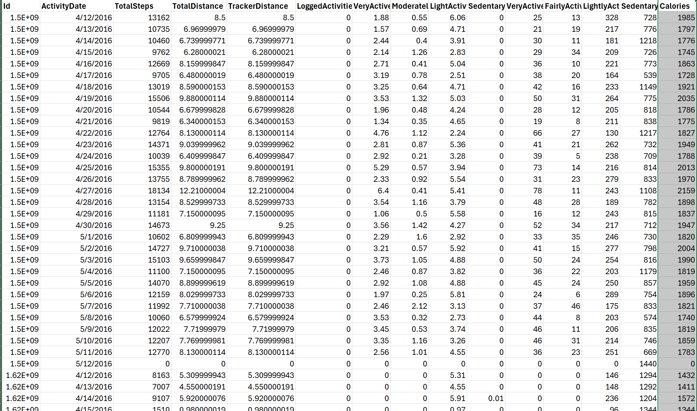
Dataset (FitBit smart watch dataset)

Slide 5
Objectives
Fitness Tracking: In the context of fitness tracking, integrating a calorie prediction model can help provide a more holistic view of a user's energy expenditure and intake. This can be beneficial for tailored fitness coaching and personal training.
Using Machine Learning helps catch the patterns and give more accurate expenditure results
Visualization is the key to fitness data and it helps users keep themselves in track.
Automating such daily/monthly receiving data pipeline and creating a proper architecture to store them is important.

Slide 6

Cloud Architecture

Slide 7
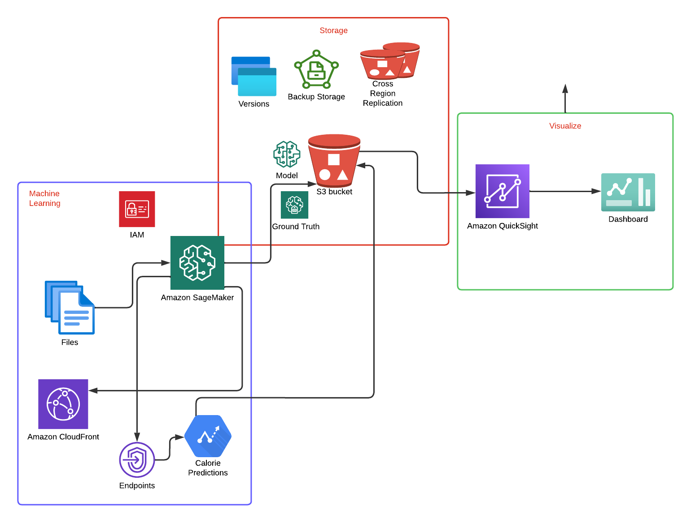

Slide 8

Well- Architect Framework

Slide 9
Operational Excellence - Used CloudWatch and QuickSight to make sure the op- erations run smoothly.
Security - IAM role is used for the sagemaker to use in AWS CLI.
Reliability - S3 Deep Archive is used for archiving the bucket contents after 180 days of operation, Cross Region Replication is done for the bucket to ensure the data remains accessible always despite the region being down, Bucket Versioning is done to see the file versions for backup and safety.
Cost Optimization - GPU is not used to reduce cost as the data is quite small, Spot Instances is enabled to be used during training which shows 50 percent reduction in the cost.
Performance- S3 is used as it is scalable, reliable and hassle free. It provides quick access to the necessary data.
Sustainability - Spot instances are used, GPU is avoided and also the end points are made sure to be deleted to avoid any over-consumption of resources.

Slide 10
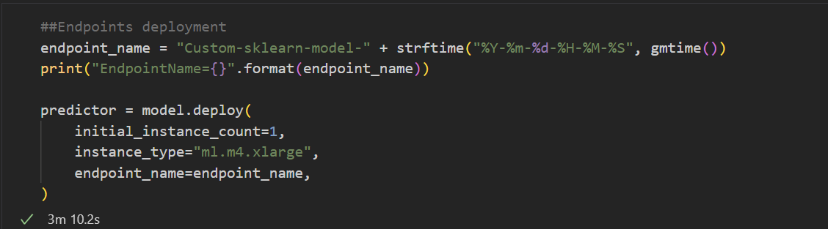
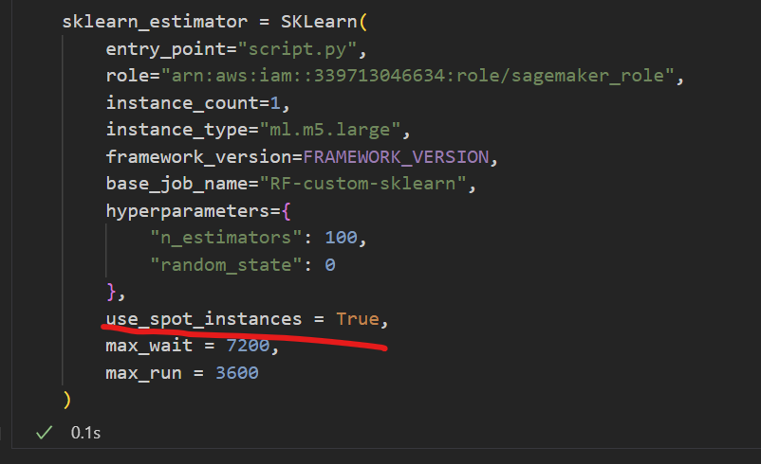
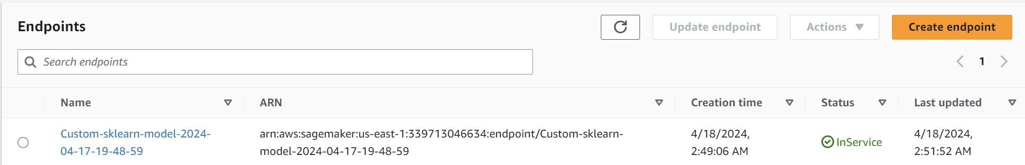
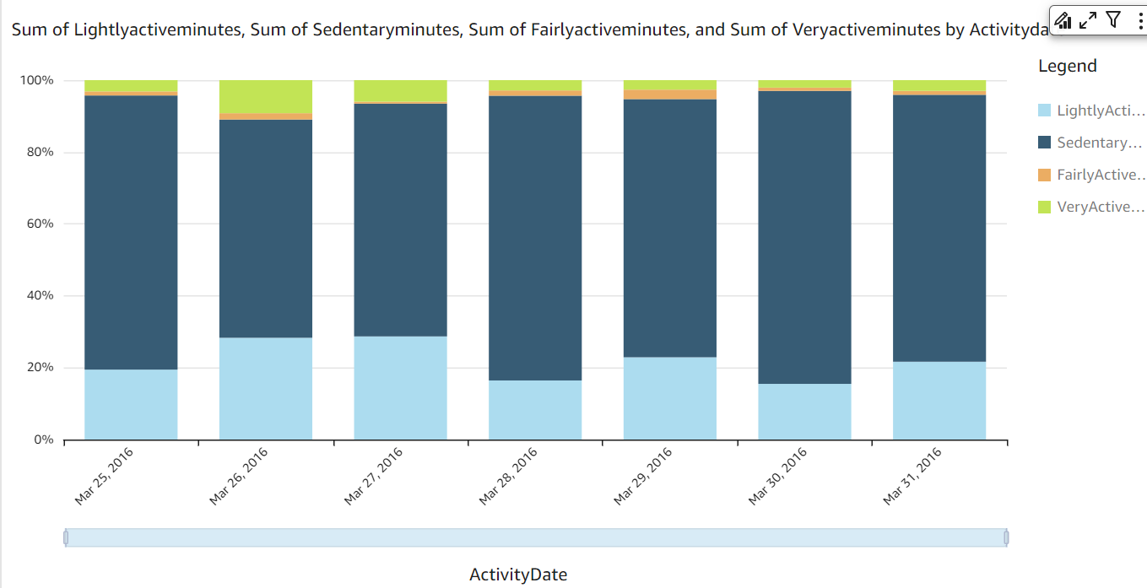
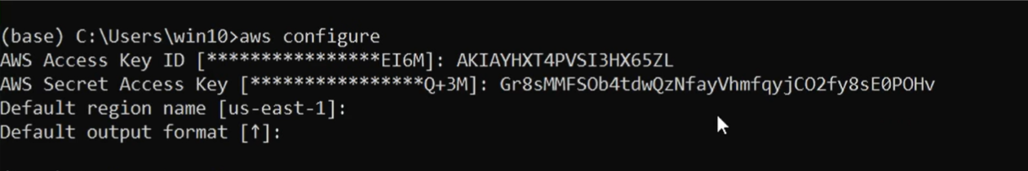
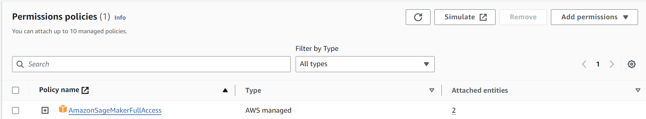
Some implemented features

Slide 11
Future work and failed attempts
Trying to use Sagemaker endpoint to be triggered from Lambda function was a fail
Using Athena and Glue initially but my project did not require ETL in so much depth so modified the architecture
Played around with RDS but the cost would add up so did not end up using it
Automate the pipeline using other alternative for Lambdacl

Slide 12
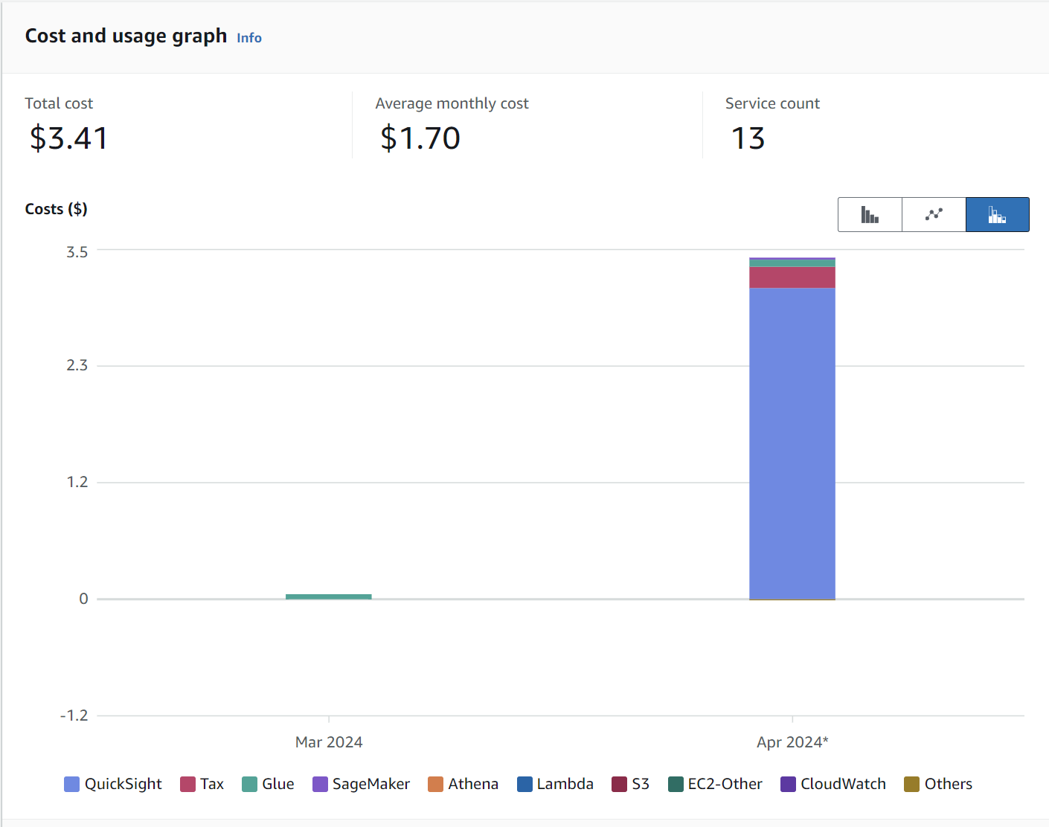

Slide 13

Demonstration

Slide 14

Any questions?

Slide 15
Thank you!

